Slide 1


K.RAMAKRISHNAN COLLEGE OF TECHNOLOGY
(AUTONOMOUS), TRICHY.
DIGITAL NOTICE BOARD
PRESENTED
AKASH . R
230381171-421006
SUPERVISOR
Mr. M. Saravanan, M.E.,
AP/CSE.
Notes:
1

Slide 2
PRESENTATION OVERVIEW
Objective
Project Introduction
Problem Statement
Methodologies (Programming concepts relevant to problem statement)
Architecture of the proposed system
List of Modules
Merits
Results and Discussion
Queries
Notes:
2

Slide 3
OBJECTIVE
This Java program provides a GUI-based weekly timetable for meetings, allowing users to view schedules for each day by selecting buttons. It dynamically updates the displayed timetable and includes a real-time clock for current date and time. The application simplifies daily and weekly meeting management with an intuitive interface.
Notes:
3

Slide 4
PROJECT INTRODUCTION
This project is a Java-based GUI application designed to manage and display a weekly timetable of meetings. Users can view the schedule for any day of the week by clicking on dedicated buttons, with details like time, meeting name, and location displayed in a structured format.
A real-time clock updates the current date and time, adding functionality and practicality. This application aims to streamline schedule management, making it accessible and user-friendly for professionals and teams.
Notes:
4

Slide 5
PROBLEM STATEMENT
Managing daily and weekly meeting schedules can be challenging, especially when juggling multiple meetings across different days, times, and locations. Without an organized system, users may struggle to keep track of their appointments, leading to missed meetings or confusion.
There is a need for a user-friendly solution that provides a clear and accessible interface for viewing and managing weekly schedules, ensuring users can efficiently plan their activities and stay updated in real-time.
Notes:
5

Slide 6
METHODOLOGIES
1.Design and Development:
Created a Java-based GUI using Swing, featuring a grid layout for meeting schedules, navigation buttons for daily updates, and a real-time clock for current date and time.
2. Testing and Deployment:
Tested functionality for dynamic updates and interface responsiveness, ensuring user-friendly navigation and accurate timetable display before deployment.
Notes:
6

Slide 7
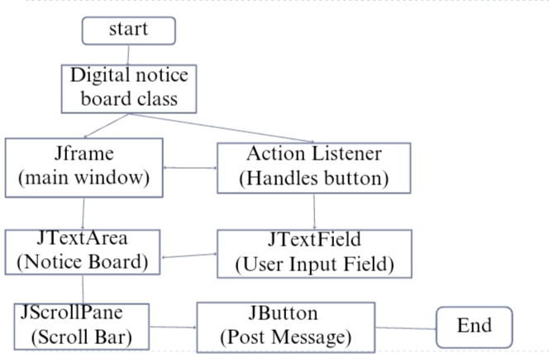
ARCHITECTURE OF THE PROPOSED SYSTEM
Notes:
7

Slide 8
LIST OF MODULES
Main Window Module.
Date and Time Display Module.
Timetable Panel Module.
Navigation Buttons Module.
Data Storage Module.
Timetable Update Module.
Helper Utilities Module.
Notes:
8

Slide 9
MERITS
1. Interactive and User-Friendly Design:
The application provides an intuitive GUI with navigation buttons for each day, making it easy for users to access daily schedules.
2. Dynamic and Real-Time Features:
The timetable updates dynamically based on user input, and the real-time clock displays the current date and time for added functionality.
3. Efficient Data Management:
Meeting schedules are organized using a multi-dimensional array, ensuring easy access, modification, and scalability.
Notes:
9

Slide 10
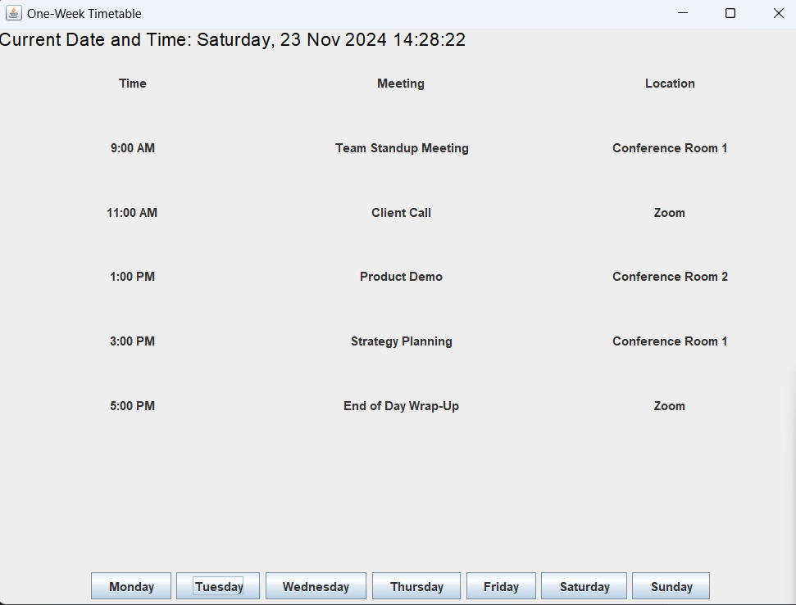
RESULTS AND DISCUSSION
Notes:
10

Slide 11
QUERIES ?
Notes:
11

